Slide 1

Understanding Large-Scale Dynamic Purchase Behavior
Midterm Presentation
Sun Yan, Wang Qiuting, Kou Shangrui
Big Data Marketing
MKT 4220
2022.06

Slide 2
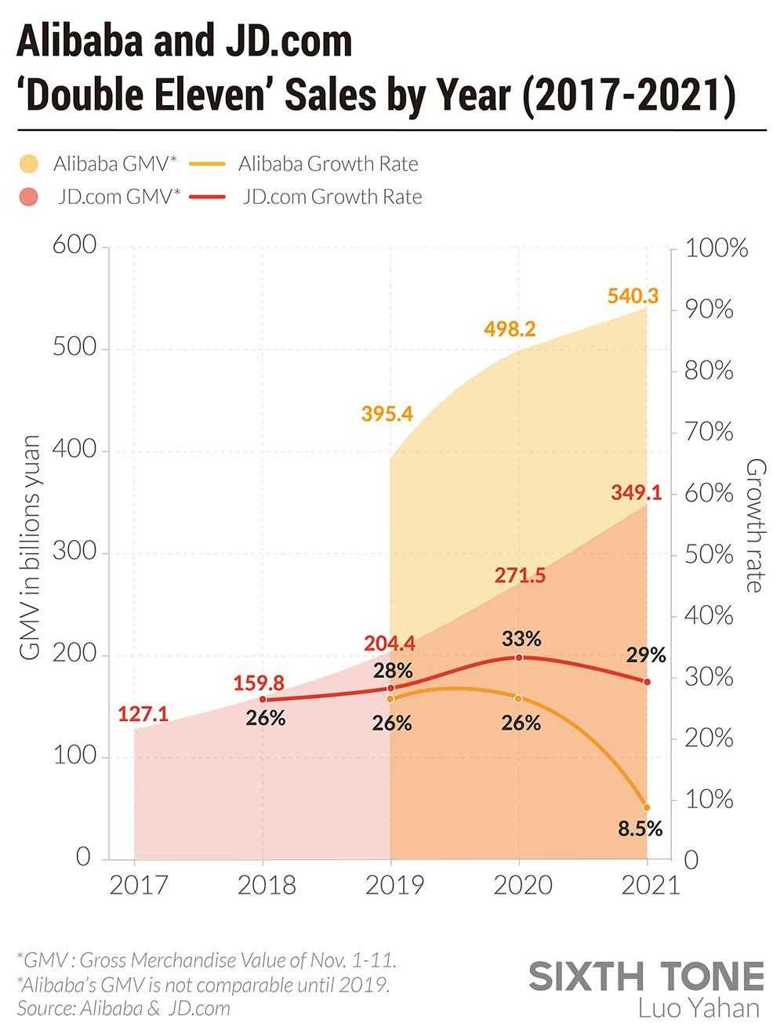



Background Information & Research Question
Large-scale purchasing data with various categories, quantities, and time periods are made by customers during shopping trips.
Data Mining
Exponentially growth in many parts of the retail landscape and online shopping.
Crowded with competitors, competitive advantages of retailers should be found out.
How to analyze large-scale historical purchasing data to reveal customer preferences and improving marketing activates?
1. Introduction
Personalized Communication
Targeted
Advertising
Practical Significance
Cost Saving
Product
Recommendation
1. Introduction
2.Literature Review
3.Methodology
4.Result
5. Conclusions

Slide 3

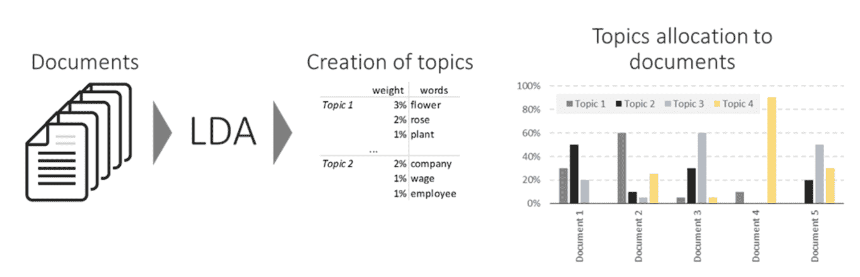


Previous Research Foundations
Probabilistic topic models, Blei (2012)
Contributions: Research on probabilistic topic models in text analysis use Latent Dirichlet Allocation (LDA).
Model-Based Purchase Predictions for Large Assortments, Jocobs et(2016)
Contributions: first apply LDA-X topic modeling and text analysis framework to purchase historical data, labeling motivations as driver of customer behavior.
Limitations: 1) Ignore time-specific effects 2)Assume all correlations between motivations are negative.
2. Literature Review
Crumbs of the Cookie: User Profiling in Customer-Base Analysis and Behavioral Targeting, Trusov (2016)
- Contributions: Dividing cookies into small different time periods and take correlations between topic relevance into consideration.
- Limitations: 1) Only use small size of datasets and variables 2) The computational algorithms are not efficient enough to handle large scale datasets.
1. Introduction
2.Literature Review
3.Methodology
4.Result
5. Conclusions

Slide 4
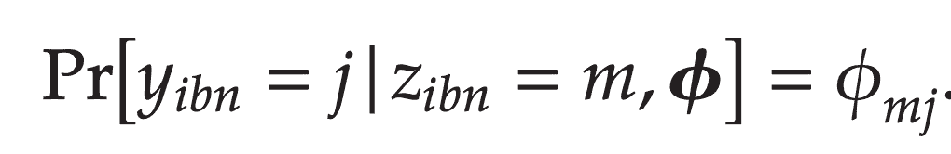

Model: enhanced LDA-X implies…
Motivations
M motivations
: product
Purchase History Data
Soft cluster
1
0
The probability that product j is purchased, given that the underlying motivation for this purchase decision is motivation m,
trip 1: product 1, product 2, …
Purchase probability
Motivation m
3. Methodology
trip 2: product 3, product 7, …
…… trip Bi: product 10, …
Motivation-product
Probability distribution
𝟇mj
Motivation
relevance
I customers: {1, 2, …, i, …, I}
J products: {1, 2, …, j, …, J}
Bi trips: {1, 2, …, b, …, Bi}
The selection of these motivations follows the motivation mixture weights for this shopping trip
Label: product type
Purchase trip b
𝜭ib
Purchase-motivation
Probability distribution
Supervised learning
1. Introduction
2.Literature Review
3.Methodology
4.Result
5. Conclusions

Slide 5
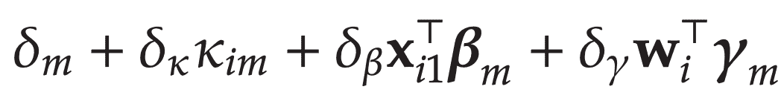

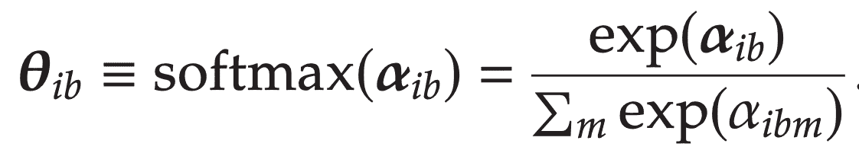
Model Purchase Motivation
b=1
𝛀: 𝝓, 𝝁𝜅, 𝝨𝜅, 𝝆m, 𝞫m, 𝜸m, …
𝜭ib is drawn from logistic Normal distribution with a parameter vector 𝜶ib, which is a linear model.
3. Methodology
𝜅im: the innate motivation m for customer i.
For 𝜅i=[𝜅i1, …, 𝜅iM] we specify a multivariate Normal distribution with mean μ𝜅 and covariance Σ𝜅 (motivation correlation)
[0, 1]→prob.
𝜶ibm: a measure of the latent relevance of motivation m in the bth shopping trip of customer i
𝜶ib-1: previous alpha at b-1th shop trip - VAR(1)
𝒙ib: explanatory variables specific to bth shop trip
𝐰i: explanatory variables time-invariant
1. Introduction
2.Literature Review
3.Methodology
4.Result
5. Conclusions

Slide 6
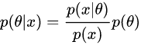
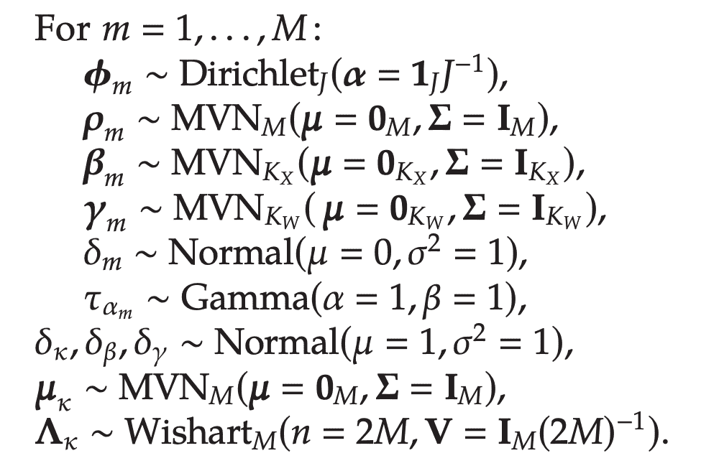
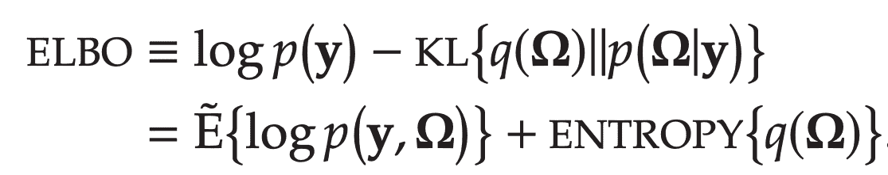
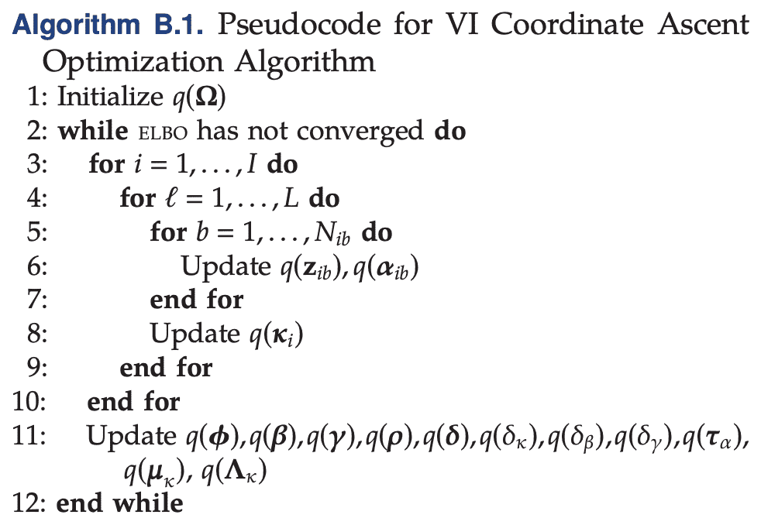
Variational Inference
Bayesian statistical inference
posterior distribution
find q(𝛀), variational distribution, that is the closest to the posterior
inferred motivations: 𝝓
effects of explanatory variables: 𝞫m, 𝜸m
motivation relation: 𝝨𝜅
lagged motivation relevance: 𝝆m
P(𝛀|y)
𝛀: 𝝓, 𝝁𝜅, 𝝨𝜅, 𝝆m, 𝞫m, 𝜸m, …
Objective
function:
ELBO: Evidence Lower Bound (KL divergence)
maximize variational expectation of joint distribution of y and 𝛀, while increase entropy of q.
max
3. Methodology
Algorithm:
Coordinate Ascent:
iterates over the subsets of parameters
and guarantees to reach at least a local optimum.
q* under the mean-field assumption: distributions in the exponential family
1. Introduction
2.Literature Review
3.Methodology
4.Result
5. Conclusions

Slide 7
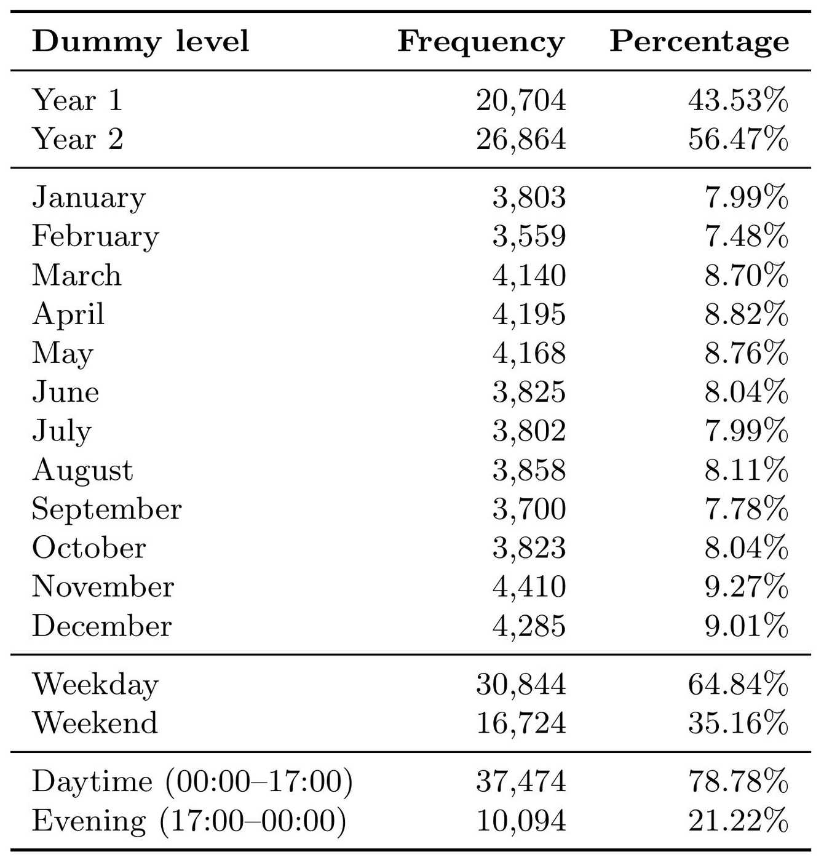
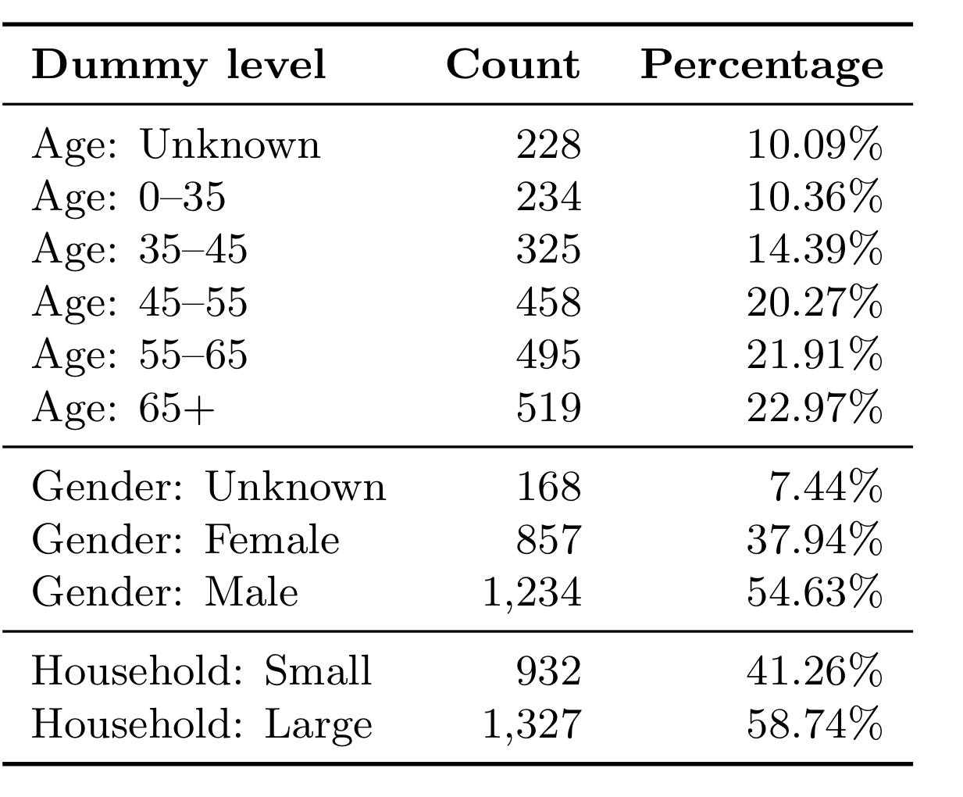

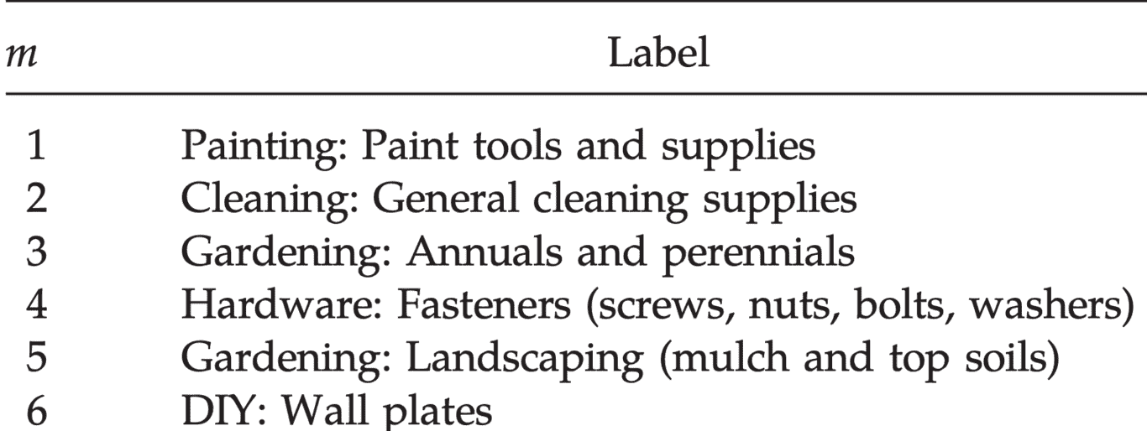
Experiment: Large-scale Data
Source
Preprocess
Merge infrequent products
(e.g. record [Group, Class, Subclass] as the same products)
Split data set into two parts: in-sample; out-of-sample
Identify motivation labels from products taxonomy:
A Fortune 500 Specialty Retailer’s purchase data: 139,622 purchases of
Time: 47,568 shopping trips from Mar 5, 2012 to Mar 4, 2014. ⇒ 𝒙ib (specific to bth shop trip)
Customer: 2,259 people with age, gender, household size. ⇒𝐰i (time-invariant)
Products: 4,266 distinct of [Group, Class, Subclass, Description]
3. Methodology
1. Introduction
2.Literature Review
3.Methodology
4.Result
5. Conclusions

Slide 8
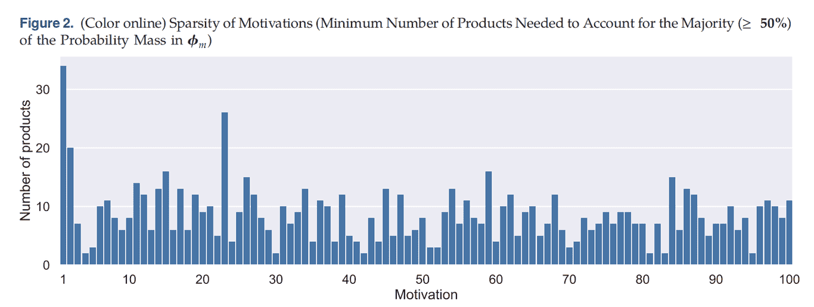
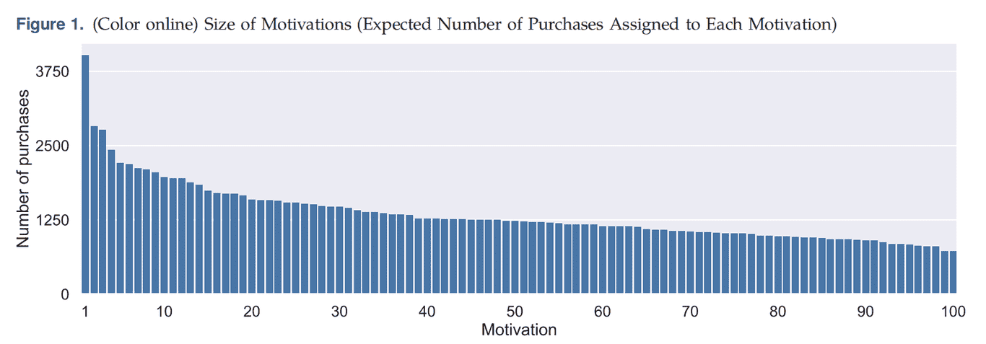
4.1 Purchase Motivations - 𝝓m
An important message:
The majority of the motivations is very sparse.
“> 50% purchases” “< 10 products”
set M=100
4. Result
Special case (m = 1):
largest but least sparse motivation
Plausible
Broad motivation is more likely to appeal to a large part of the customer base
1. Introduction
2.Literature Review
3.Methodology
4.Result
5. Conclusions
Notes:
图示删去
提炼观点+an important message from this paper: …

Slide 9
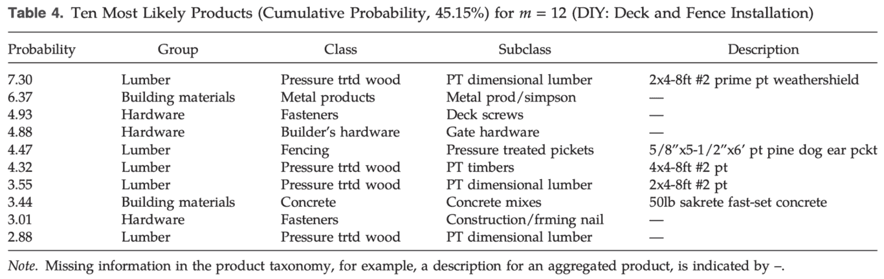
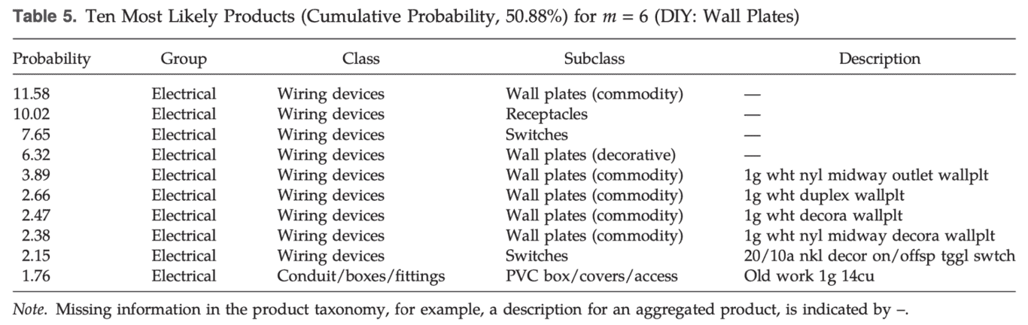
4.1 Purchase Motivations - 𝝓m
An important message:
Use motivation, instead of existing product categories
m=12 spread out across
3 groups
6 classes
8 subclasses
4. Result
Flexible to category !
m=6 spread out across
1 groups
2 classes
5 subclasses
1. Introduction
2.Literature Review
3.Methodology
4.Result
5. Conclusions
Notes:
图示删去
提炼观点+an important message from this paper: …

Slide 10
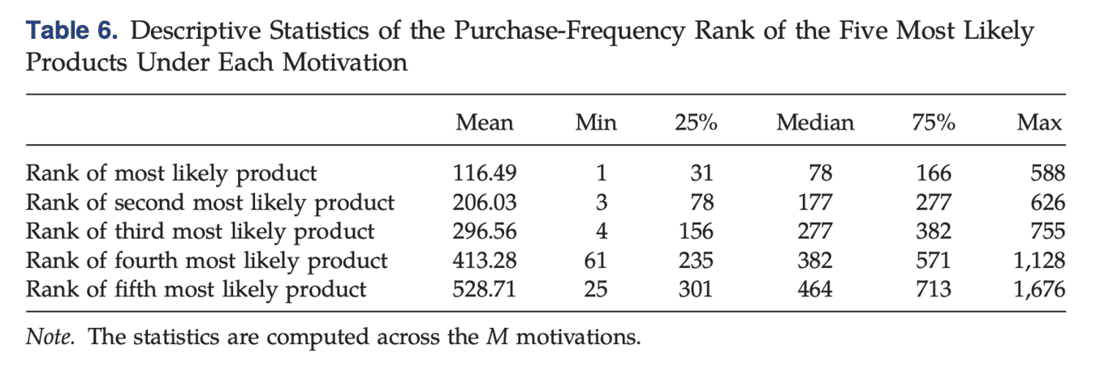
4.1 Purchase Motivations - 𝝓m
An important message:
Some highlight infrequently-purchased products
other motivations are driven by high volume products
Motivation 23: most likely product
588-th purchase volume among all product
4. Result
Motivation 4: most likely product
1-st purchase volume among all products
By motivations, our model is able to highlight purchase patterns that also involve low-volume products.
1. Introduction
2.Literature Review
3.Methodology
4.Result
5. Conclusions
Notes:
图示删去
提炼观点+an important message from this paper: …

Slide 11
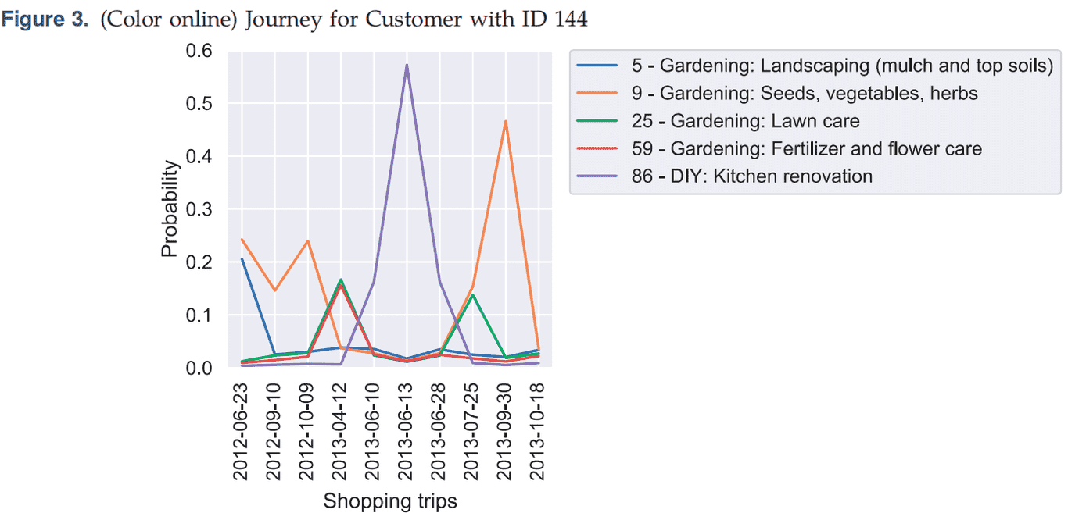
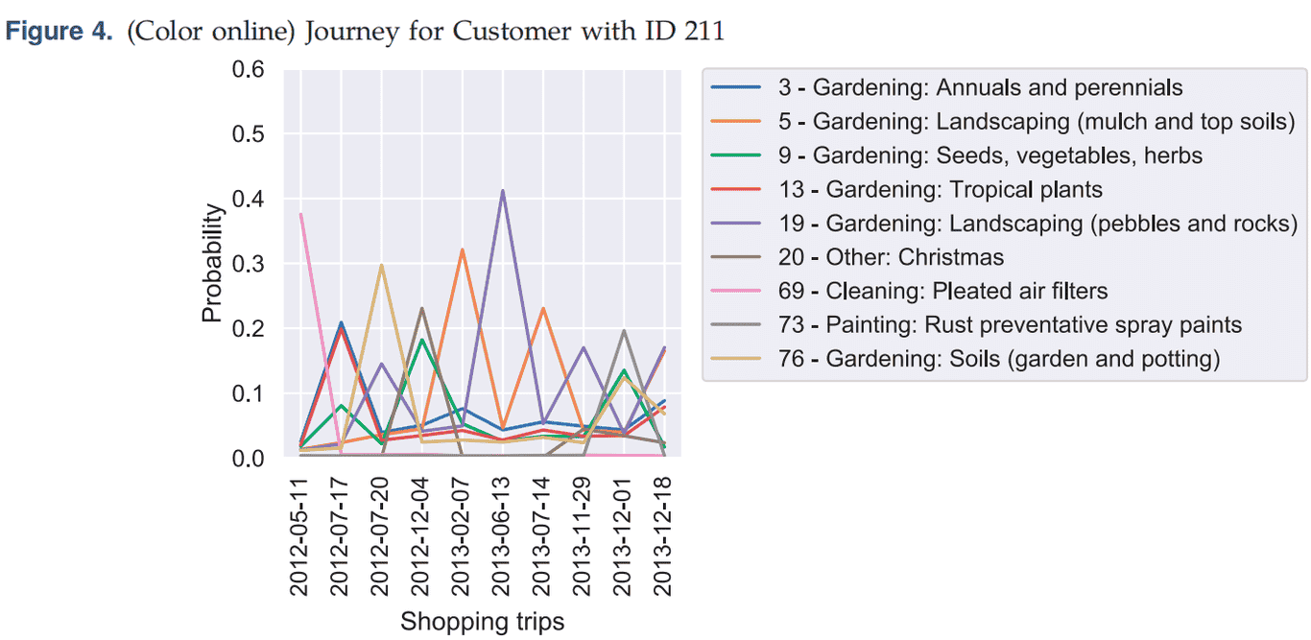
4.2 Customer Journey
4. Result
Gardener
Gardener
Do-it-yourselfer
Landscaping
The customer journey can be succinctly described and visualized using the identified motivations.
to model buying behavior at the shopping trip level rather than at the customer level.
to find more subtle motivations for describing customer profiles more precisely.
1. Introduction
2.Literature Review
3.Methodology
4.Result
5. Conclusions

Slide 12
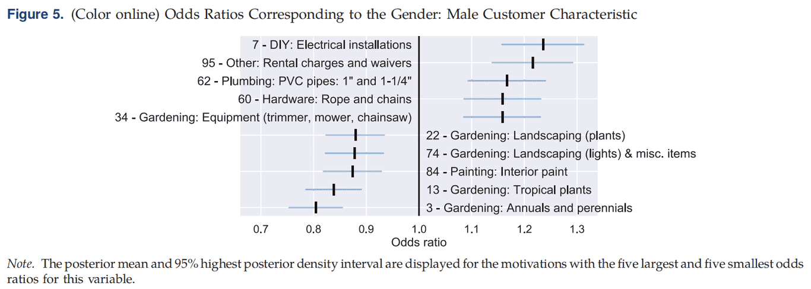
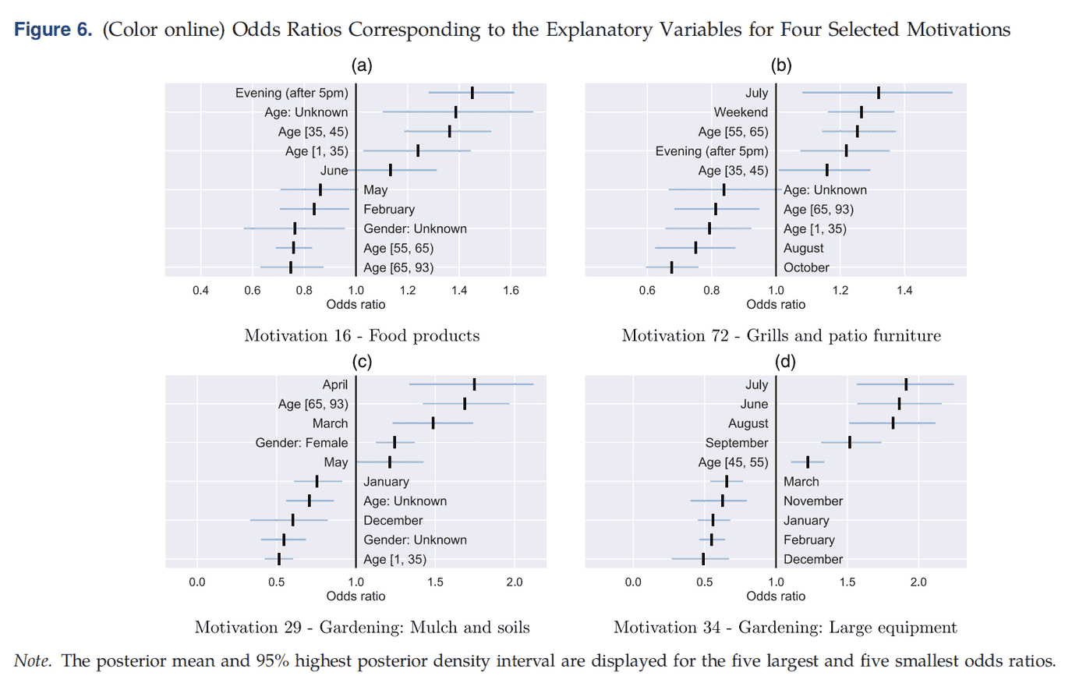
4.3 Effects of Explanatory Variables - 𝒙ib, 𝐰i
Explanatory variables
Advantages:
Enabling marketers to identify segments of the customer profile that are relevant to the motivation.
Explanatory variables can help describe and explain motivations.
Motivation
4. Result
Large positive likelihood during the evening and for younger customers
m=16: food products
1. Introduction
2.Literature Review
3.Methodology
4.Result
5. Conclusions

Slide 13
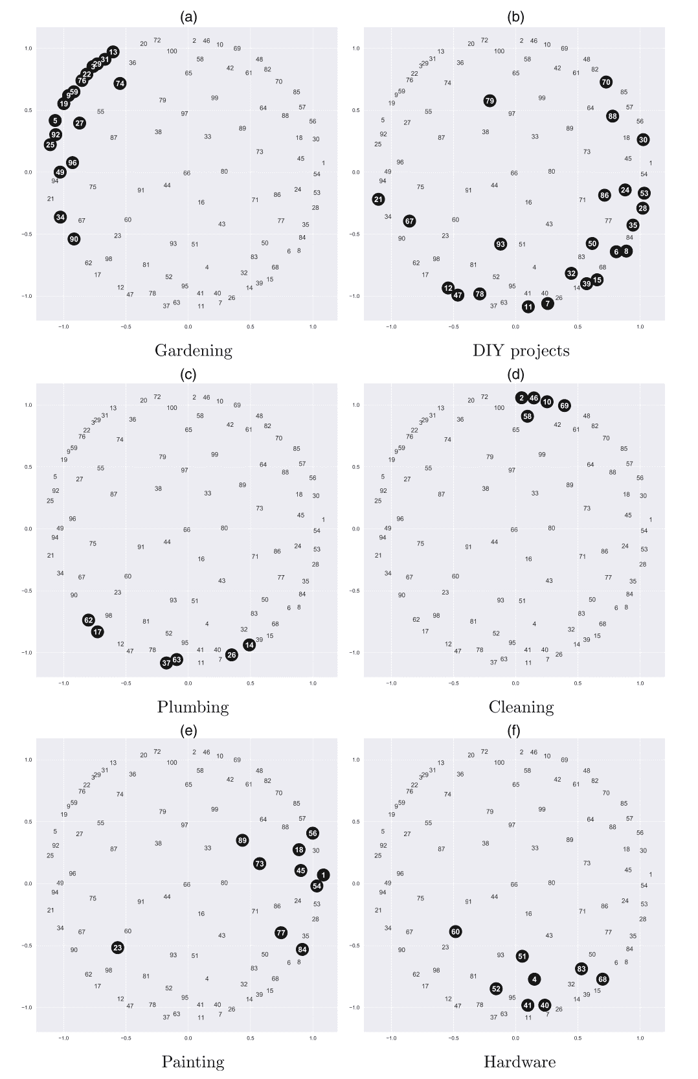
4.4 Relations Between Motivations - 𝚺𝜅
Recall:
Visualize the relationships between all M motivations as captured by the correlation matrix by Multidimensional scaling (MDS) techniques
Motivations that have a strong positive correlation will be placed close together in the MDS space.
Most of the themes are concentrated in different regions in the graph
4. Result
Specifically,
Plumbing and Hardware overlap in location with the DIY projects.
For painting, all but one of these motivations are placed close together.
1. Introduction
2.Literature Review
3.Methodology
4.Result
5. Conclusions
Notes:
介绍MDS图可以照读paper的分析
This could be expected, as plumbing can be seen as a special case of a DIY project, and hardware is needed to complete a DIY project.

Slide 14
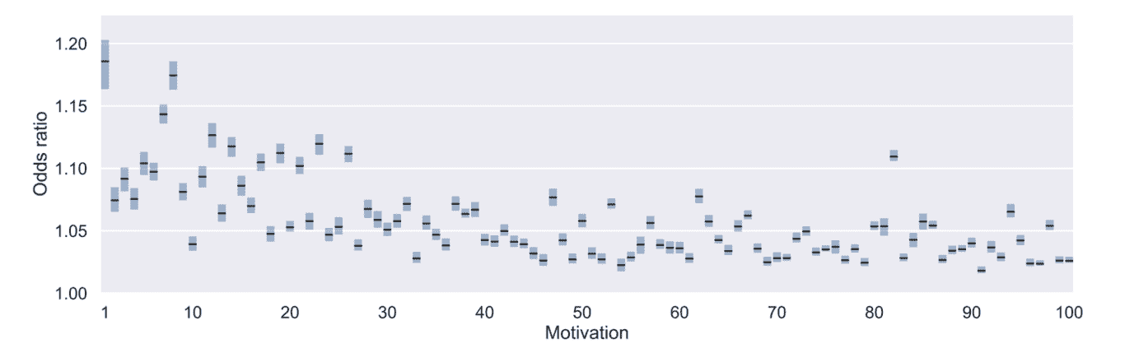
4.4 Relations Between Motivations - 𝝆m
Recall:
.
𝝆m: the effect of the lagged motivation relevance vector (𝜶ib-1) on the relevance of motivation m: 𝜶ibm
𝝆mm
Own AR-effect
𝝆m =
.
.
.
Cross AR-effect
Own AR-effect
Cross AR-effect
4. Result
Tile setting
the largest odds ratio of 1.254: motivation 81 on 95.
Motivation 95: rental charges and waivers
Motivation 81 is an e-deposit product
Painting supplies
Plausible
A number of motivations have a relatively large own AR effect, such as painting supplies and tile setting. They correspond to large or persistent projects.
Although there is some variation among the cross AR effects, most odds ratios are located around unity.
1. Introduction
2.Literature Review
3.Methodology
4.Result
5. Conclusions

Slide 15
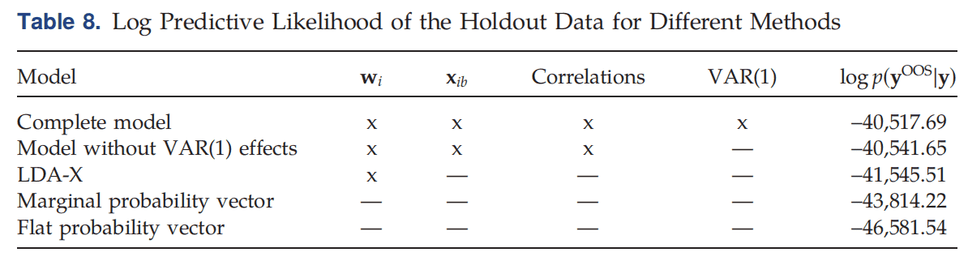
Our model clearly outperforms the alternatives.
4.5 Predictive Performances
4. Result
Our model
Our model without VAR(1) term
Benchmark, Jacobs et al. 2016
Model-free benchmarks
Test prediction on holdout data set
1. Introduction
2.Literature Review
3.Methodology
4.Result
5. Conclusions

Slide 16
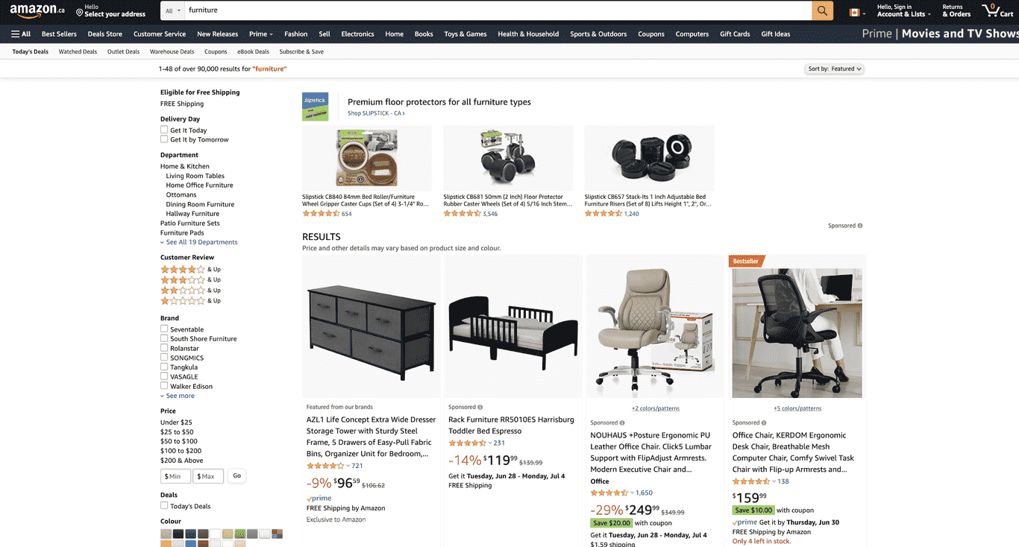
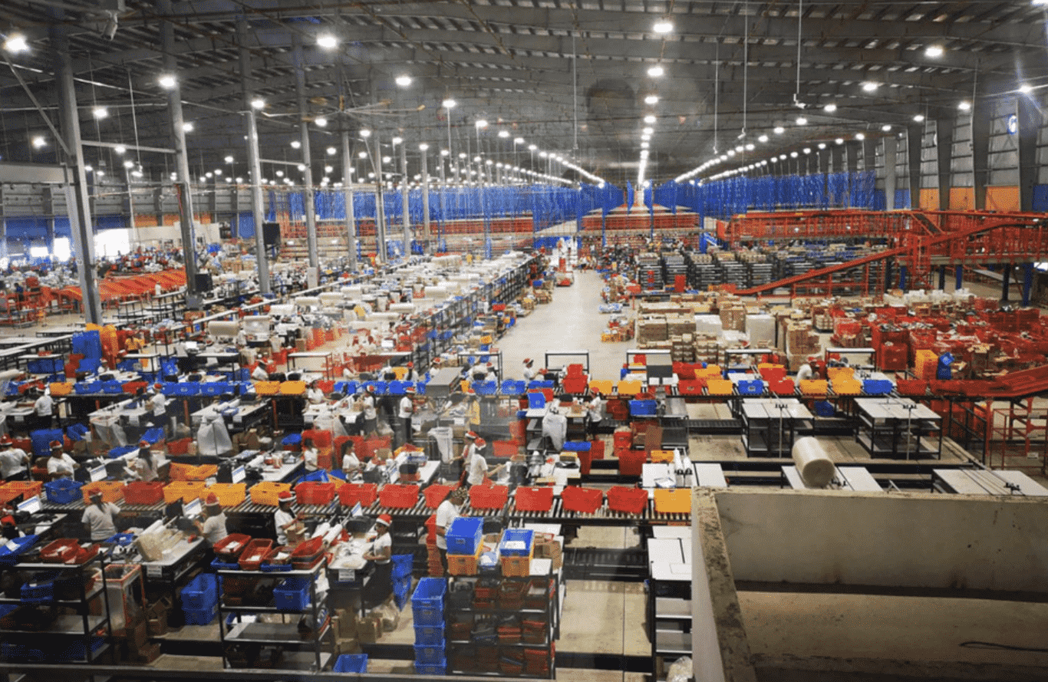
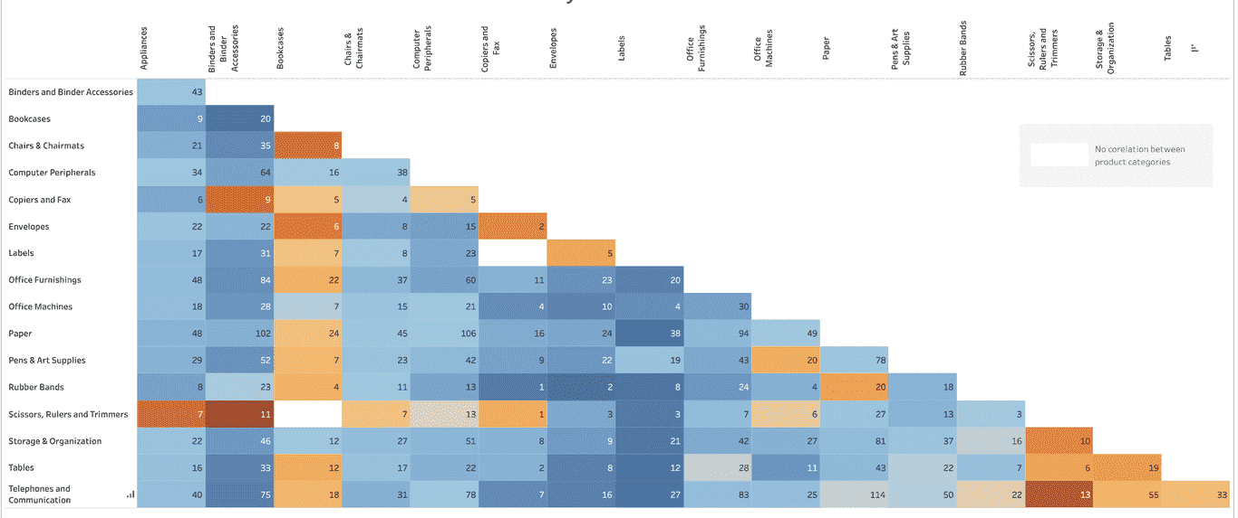
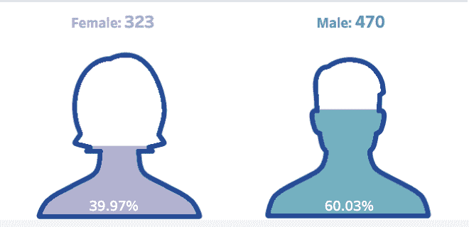
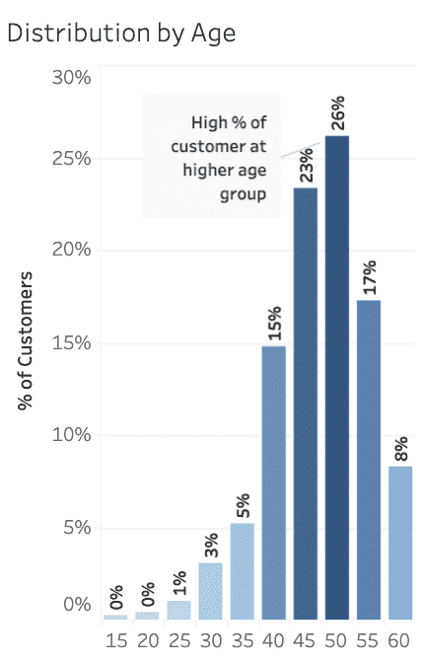
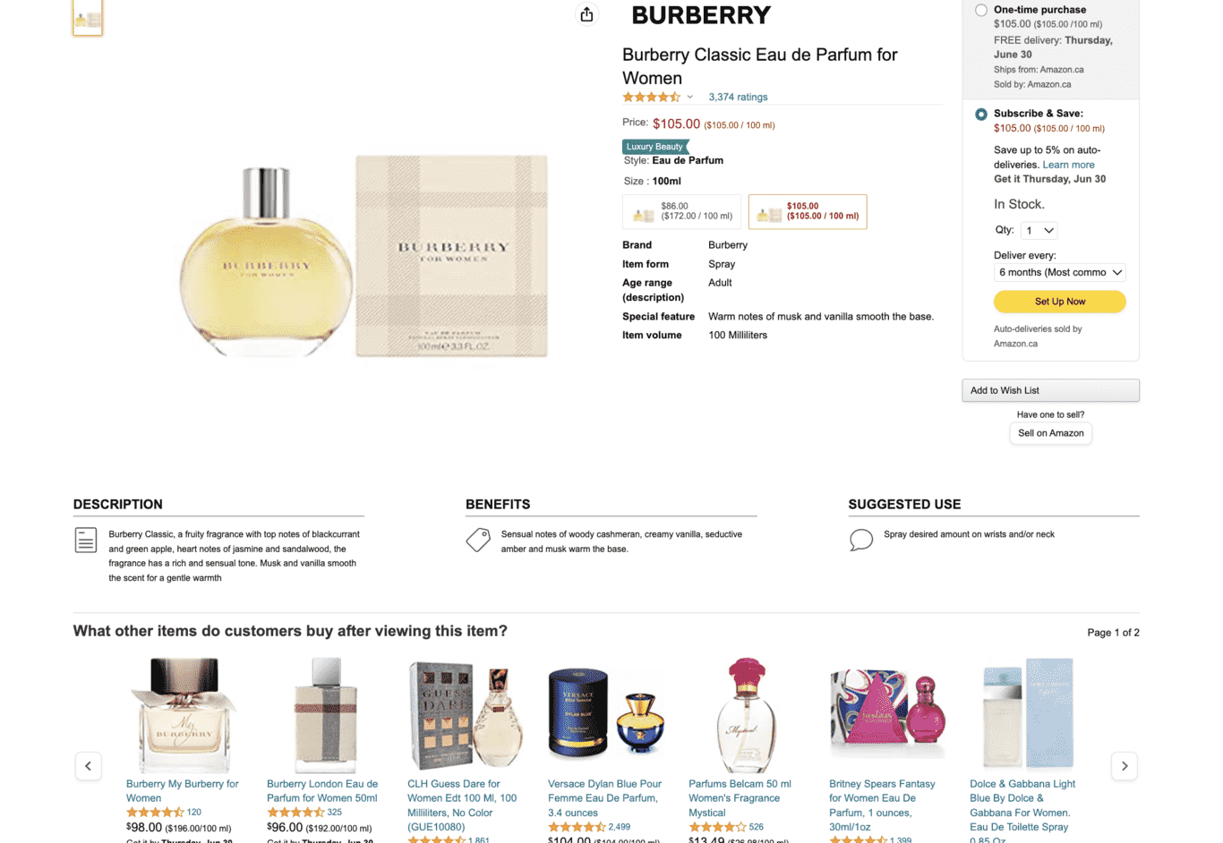
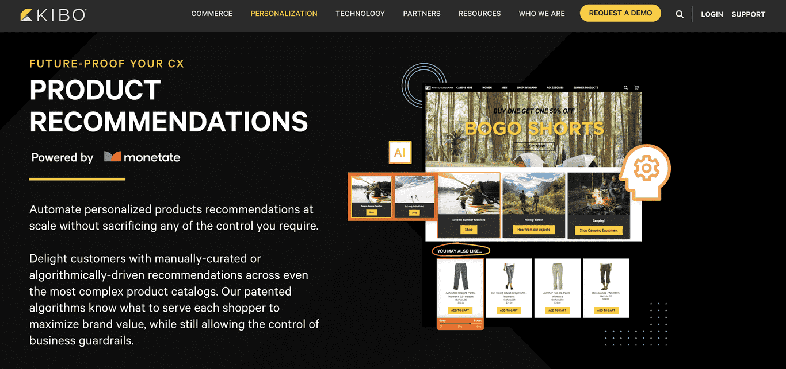
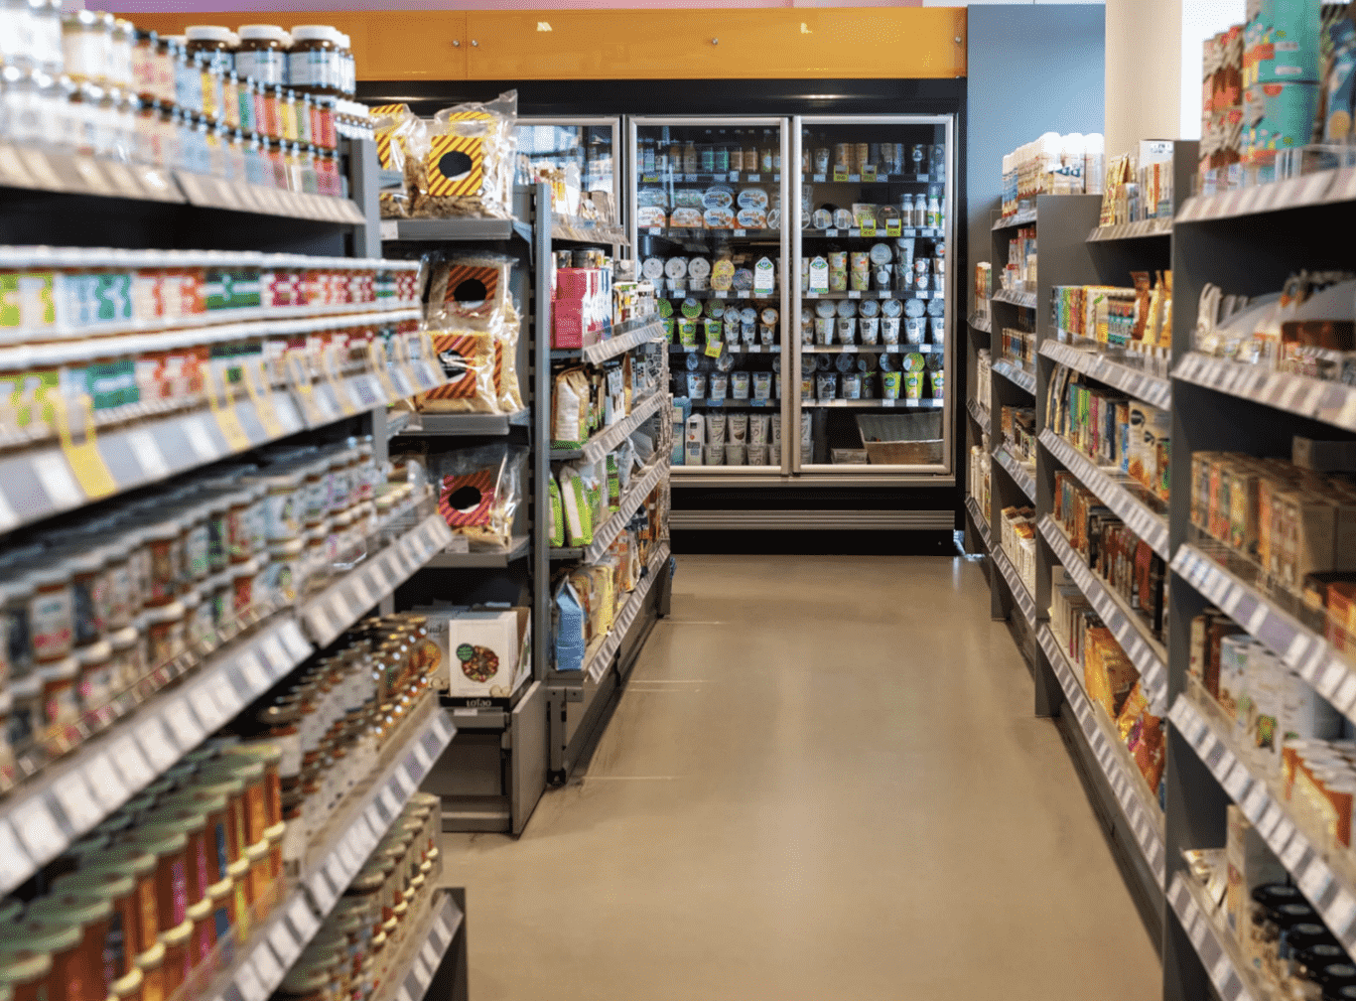
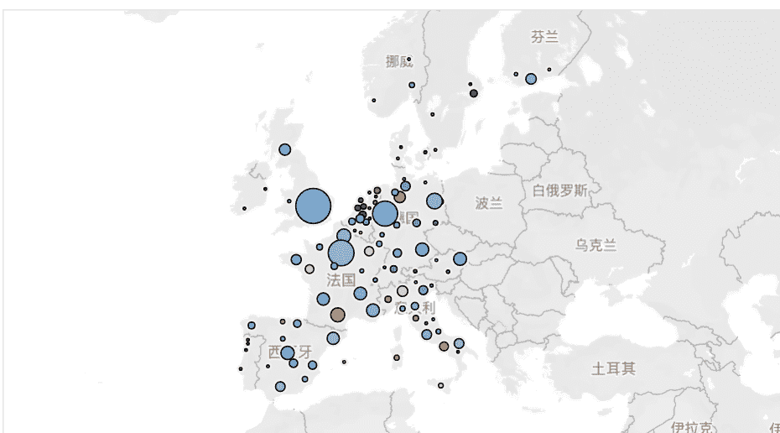
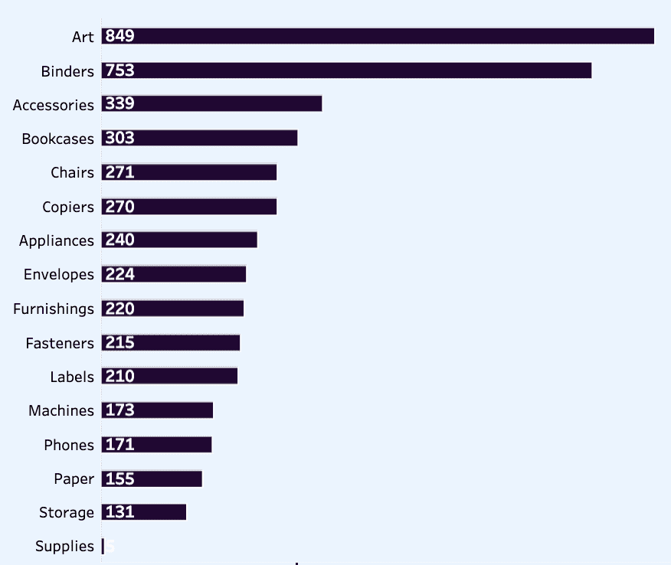
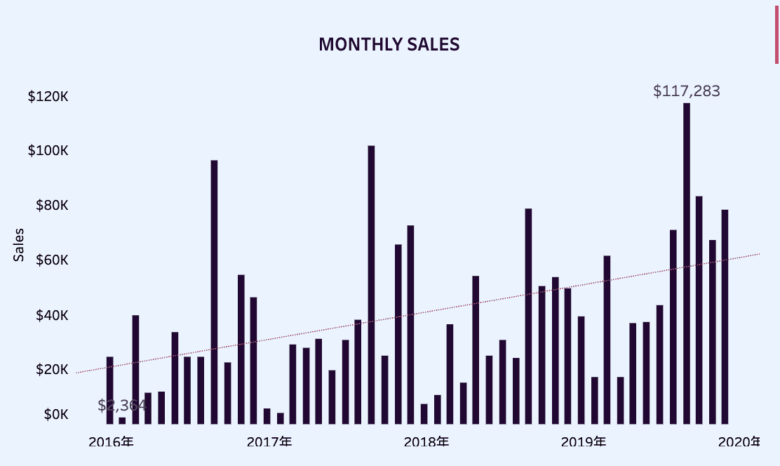
5.1 Managerial Implications
1.Establish Managerial Dashboard
Multi-Motivations Correlation
Motivation-correlations VAR(1) effects Personalized communication, Marketing Activities, Costs
Customers Feature:
Age/Region/Gender…
2.Explainable Product Recommendation
5.Inventory Management
5. Conclusions
Time
Motivations Ranking
3.Targeted Advertising
4.Improving Store Layouts
1. Introduction
2.Literature Review
3.Methodology
4.Result
5. Conclusions

Slide 17
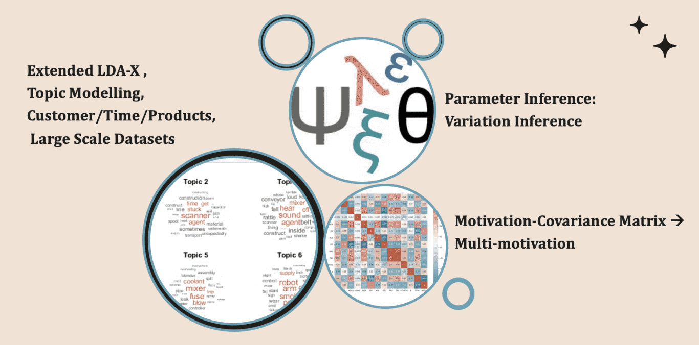
•
5.2 Model Optimization
•
•
5. Conclusions
1. Introduction
2.Literature Review
3.Methodology
4.Result
5. Conclusions

Slide 18
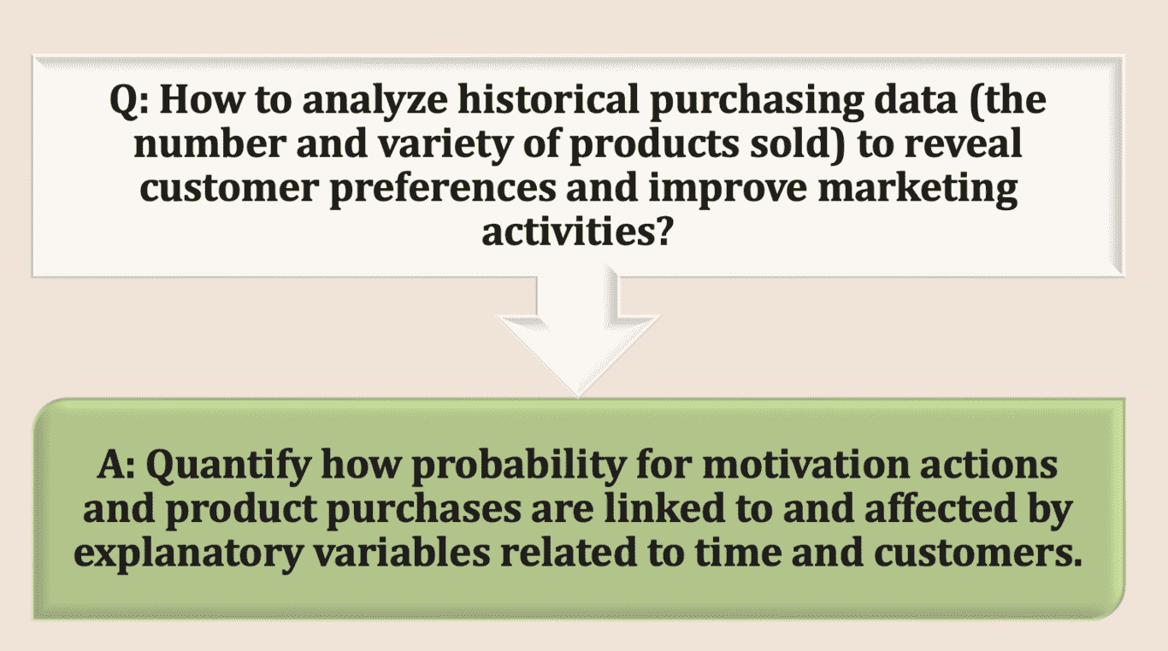
•
5.3 Deal with Research Questions
•
•
5. Conclusions
1. Introduction
2.Literature Review
3.Methodology
4.Result
5. Conclusions

Slide 19
5.4 Limitations & Further Research Directions
Limitations | Further Research Area
1. Purchase behaviors are partially controlled by retailers. | Product prices, promotion strategies, and store layout, should be controlled for inference motivations.
2. A product customer purchased is not necessarily the same as the recommendation one. | The effectiveness of product recommendations should be discussed further.
3. The inferred motivation structure model hasn’t already been put into practice. | Test whether inferred motivation structure is effective for marketing actions that build on the insights generated by our model.
5. Conclusions
1. Introduction
2.Literature Review
3.Methodology
4.Result
5. Conclusions

Slide 20
Thanks!
Do you have any questions?

